Slide 1
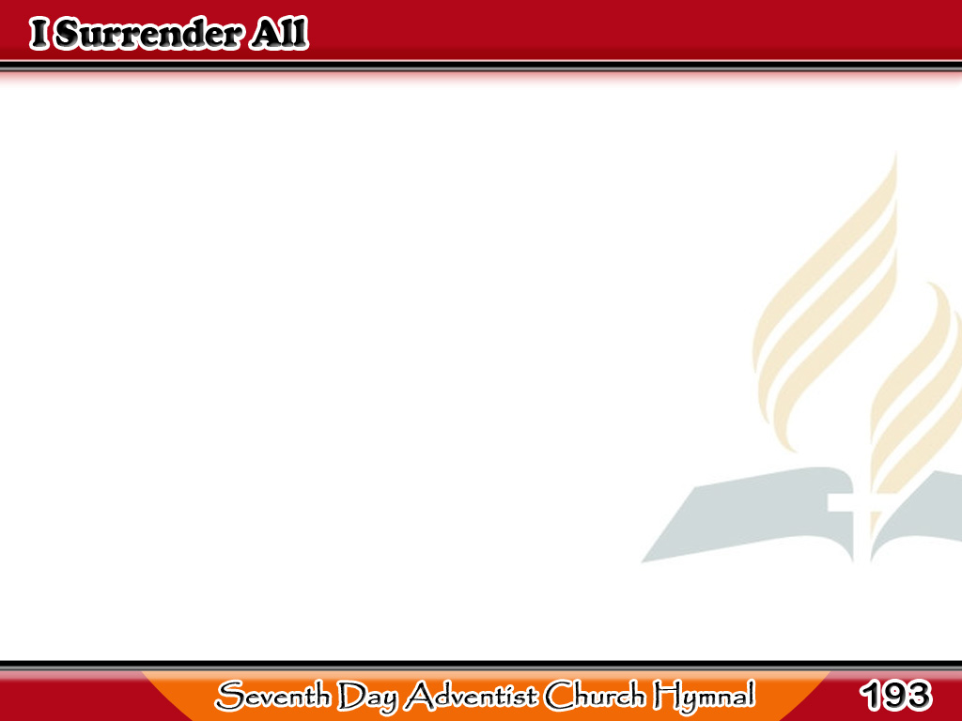
Lahat ay Aking Ihahandog
All to Jesus I surrender,
All to Him I freely give;
I will ever love and trust Him,
In His presence daily live;
1/4

Slide 2
Lahat ay Aking Ihahandog
-Refrain-
I surrender all,
I surrender all,
All to Thee, my blessed Savior,
I surrender all.
1/4

Slide 3
Lahat ay Aking Ihahandog
All to Jesus I surrender;
Humbly at His feet I bow,
Worldly pleasures all forsaken;
Take me, Jesus, take me now;
2/4

Slide 4
Lahat ay Aking Ihahandog
-Refrain-
I surrender all,
I surrender all,
All to Thee, my blessed Savior,
I surrender all.
2/4

Slide 5
Lahat ay Aking Ihahandog
All to Jesus I surrender;
Make me, Savior, wholly Thine;
Let me feel the Holy Spirit,
Truly know that Thou art mine;
3/4

Slide 6
Lahat ay Aking Ihahandog
-Refrain-
I surrender all,
I surrender all,
All to Thee, my blessed Savior,
I surrender all.
3/4

Slide 7
Lahat ay Aking Ihahandog
All to Jesus I surrender;
Now I feel the sacred flame.
O the joy of full salvation!
Glory, glory to His name!
4/4

Slide 8
Lahat ay Aking Ihahandog
-Refrain-
I surrender all,
I surrender all,
All to Thee, my blessed Savior,
I surrender all.
4/4

